Slide 1





AICTE Productization Fellowship
YUKTI Innovation Challenge 2025
Institution’s Innovation Council (IIC), AICTE
2nd Stage Evaluation
Proto ID:
IIC Institute Name:
Team Lead Name:
Theme/Sector of Focus:
Mentor Name:
Team Members:
Innovation Title: Stress Monitoring Cap

Slide 2
Assignment 1: Problem Framing/Statement Canvas
Preparation and Submission of a Problem Statement Canvas Sheet for Validation of your Idea/Prototype/Innovation
Find few Sample Problem Statement/Framing Canvas copy for Reference and Blank Formats for Fill up and Upload of the same (jpg or pdf) in the YUKTI Portal.
Please refer the example and format of Problem Statement Canvas provided at https://www.metabeta.com/blog/process/problem-statement-canvas/. Alternatively can refer the Problem Framing Canvas at https://miro.com/miroverse/problem-framing-canvas-1/

Slide 3
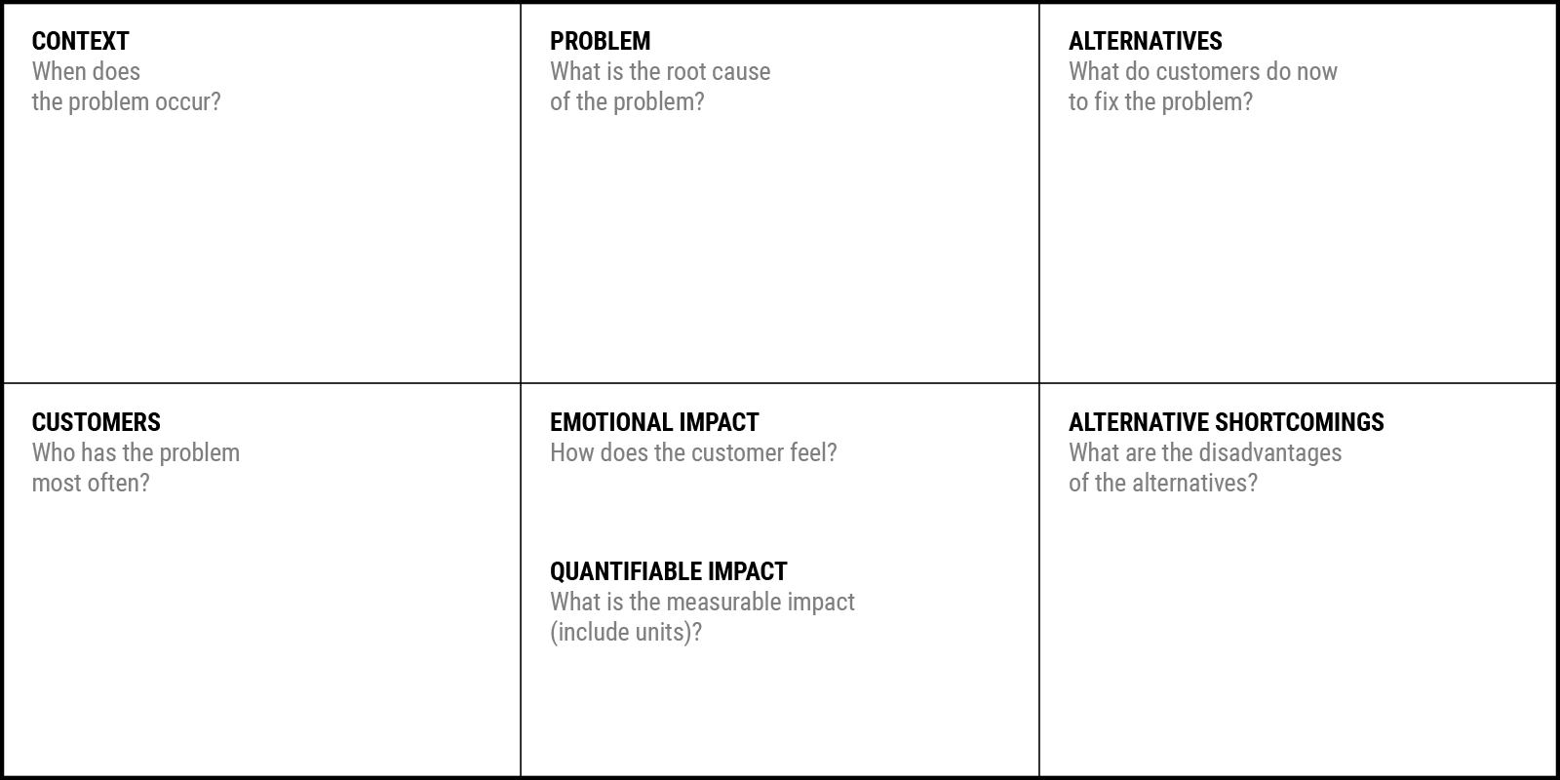
Problem Statement Canvas
YUKTI Proto ID: IR2025-983828
Idea/Innovation Title:
Wearable Brainwave Monitoring Cap to Detect and Alert Cognitive Stress
Date of Submission:
Who is your Customer Segment:
Students, corporate employees, healthcare patients, and defense personnel experiencing high mental load.
Prepared By: D Vinithri
Contact No: 8925272958
Your Answer:Cognitive stress occurs during situations of high mental workload—such as exams, tight deadlines, multitasking, long working hours, or critical decision-making scenarios. It is most common in environments with continuous pressure, lack of rest, or emotional strain. The problem often goes unnoticed because early signs of cognitive overload are subtle and difficult to detect without real-time monitoring.
Your Answer:
Use meditation or relaxation apps
Rely on wearables that measure heart rate or skin response
Visit mental health professionals occasionally
Try lifestyle changes like breaks, sleep improvement, or exercise
Use guesswork or self-observation to judge stress levels
Your Answer:
The root cause is the lack of real-time, objective tools to measure brain-based stress levels. Current stress assessments depend on subjective self-reporting, heart rate monitoring, or clinical EEG systems that are expensive, bulky, and not accessible for everyday use. This leads to delayed intervention and deteriorating mental health, productivity, and decision-making ability.
Students, corporate employees, healthcare patients, and defense personnel experiencing high mental load.
Your Answer:Customers feel overwhelmed, anxious, mentally exhausted, and unable to focus.
Your Answer:
Students: Facing exam pressure, academic stress, and performance load
Corporate Professionals: Handling deadlines, workload, and burnout
Healthcare Patients: Suffering from anxiety or cognitive overload
Defense Personnel: Working in extremely high-stress and high-risk environments
Emergency Workers: Doctors, paramedics, and first responders
Your Answer:Heart rate/GSR-based wearables measure physical stress, not cognitive stress
Meditation apps provide relaxation but cannot detect real-time brain activity
Clinical EEG systems are expensive, bulky, and not portable
Self-reporting is inaccurate and cannot detect early stress
Alternatives do not offer personalized, scientifically-backed stress management based on brainwave activity.
Your Answer:
Reduced productivity by up to 40% due to cognitive overload
Increased mistakes/poor judgment under stress

Slide 4
Assignment 2: Empathy Map/Opportunity Canvas
Preparation and Submission of an Empathy Map/ Opportunity Canvas Sheet for Validation of your Prototype/Innovation
Find few Sample empathy canvas copy for Reference and a Blank Format for Fill up and Upload of the same (jpg or pdf) in the YUKTI Portal.
Complete Guidance of Preparing Empathy Canvas with Templet Available at https://miro.com/miroverse/empathy-map-canvas-1/
Opportunity Canvas at

Slide 5
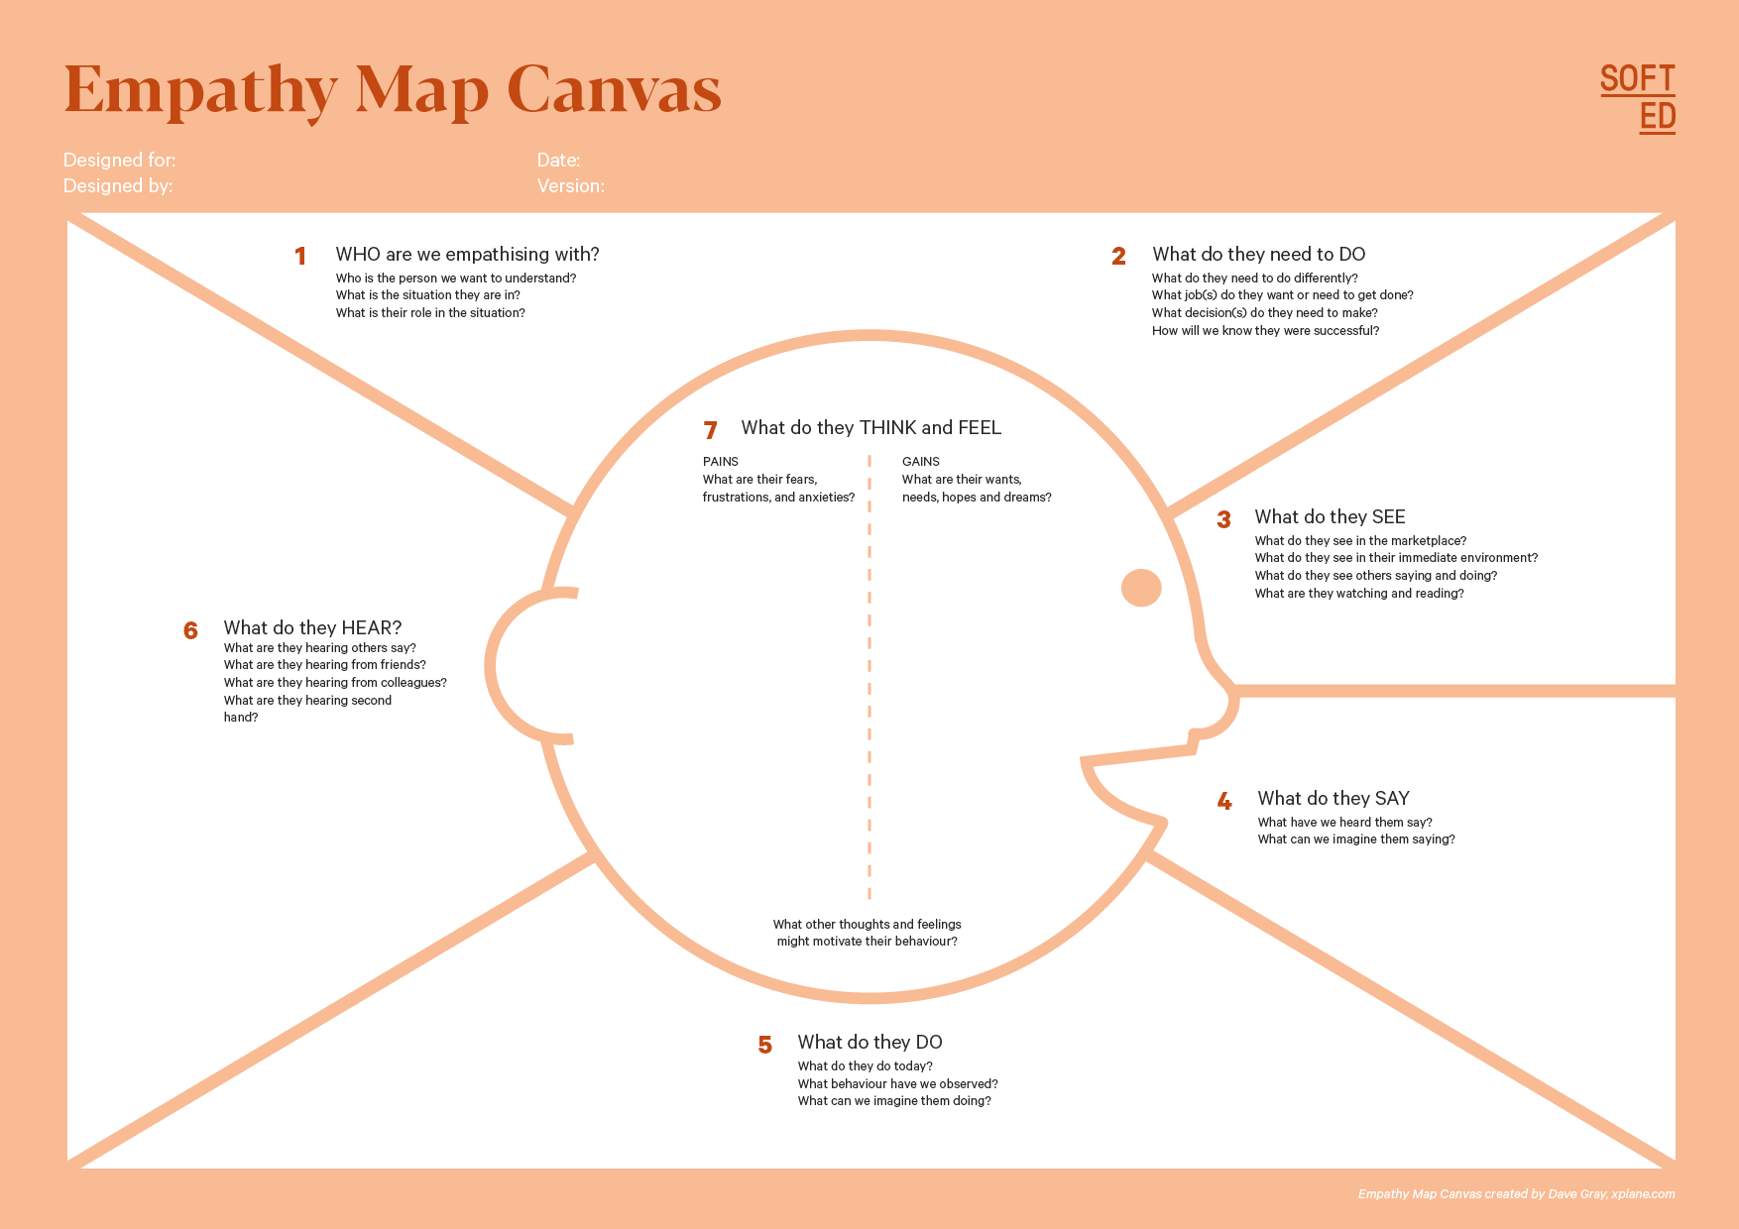
Who is your Customer Segment:
Idea/Innovation Title: Stress monitoring CAP
Designed By: S Sidesh Raj
Date of Submission: 2025-05-14
YUKTI Proto ID: IR2025-983828
Your Answer:
We are empathizing with individuals who frequently experience cognitive stress—students, corporate professionals, healthcare patients, defense personnel, and emergency workers.
They deal with mental overload, performance pressure, and an inability to detect early stress levels. Their role is to function effectively in high-pressure environments.
Your Answer:
They need to monitor their stress levels in real time and identify when their cognitive load becomes too high.
They need a reliable, non-invasive tool that alerts them before stress affects performance.
They want actionable recommendations to manage stress effectively.
Your Answer:
They see increasing stress levels in their daily tasks—academic pressure, deadlines, long work hours, or high-risk environments.
They observe others using fitness trackers or meditation apps, but none that track brain activity directly.
They see rising mental health issues around them and understand the need for better monitoring tools.
Your Answer:
They hope for a simple, wearable device that alerts them when stress increases.
They want personalized, science-backed solutions.
They desire improved focus, mental clarity, and emotional resilience.
They want better performance in studies, work, or critical tasks.
Your Answer:
Your Answer:
They fear burnout and reduced performance.
They feel anxious, overloaded, and unable to detect stress early.
They worry about their mental health and productivity.
They feel frustrated with tools that don't address cognitive stress directly.
Your Answer:
They hear from peers, teachers, co-workers, and managers that stress levels are increasing.
They receive advice to “relax more” or “manage time better,” but not solutions for real-time stress detection.
They hear about the importance of mental health but lack practical tools to track it.
Your Answer:
Your Answer:They express frustration about not knowing when stress is building up.
They say they feel overwhelmed, mentally tired, and wish for a simple tool to help them manage stress.
They often complain about burnout, poor sleep, and reduced focus.
Your Answer:
They try using meditation apps, take breaks, drink coffee/energy drinks, or rely on guesswork to manage stress.
They sometimes avoid tasks, delay deadlines, or struggle with decision-making when stressed.
They look for solutions online but rarely find tools that measure cognitive stress directly.

Slide 6
Assignment 3: Business Model Canvas
Preparation and Submission of an Business Model Canvas Sheet for Business Opportunity Validation your Prototype/Innovation
Find few Sample Business Model Validation copy for Reference and a Blank Framework for Fill up and Upload of the same (jpg or pdf) in the YUKTI Portal.

Slide 7
Idea/Innovation Title:
Stress Monitoring CAP
YUKTI Proto ID:
IR2025-983828
Hardware component suppliers (EEG sensors, ESP modules)
Manufacturing and prototyping companies
Cloud service providers (Firebase)
Universities and research labs for clinical validation
Corporate wellness programs and HR departments
Hospitals and mental health clinics
Defense organizations for specialized use cases
EdTech and health-tech distributors
Develop and refine EEG-based wearable technology
Ensure accurate signal processing and stress-level detection
Cloud integration and app development
Conduct user testing and validation
Manufacturing and quality assurance
Customer onboarding and support
Marketing, promotion, and distribution
Partnerships with institutions for deployment
We provide a portable, non-invasive EEG-based cap that detects cognitive stress in real-time and alerts users through a mobile app.
Our solution measures brainwave activity (alpha/beta waves), identifies early signs of cognitive overload, and recommends personalized stress-relief activities.
This creates proactive mental health support, improves decision-making, and prevents burnout, all through an affordable wearable system.
Continuous support through the mobile app
Personalized stress insights and recommendations
Automated alerts and notifications
Subscription-based premium analytics
Training and onboarding for institutions (B2B)
Customer support channels (chat, email, call)
Customers feel guided, supported, and empowered in managing their mental well-being.
Students facing academic pressure
Corporate professionals dealing with stress and workload
Healthcare patients with anxiety or cognitive challenges
Defense and military personnel in high-risk environments
Emergency service workers (doctors, paramedics, firefighters)
Wellness centers and mental health clinics
Educational institutions and organizations promoting mental well-being
EEG sensors and wearable hardware components
ESP32/IoT modules for wireless data transfer
Mobile app and cloud infrastructure (Firebase)
Technical team: software developers, IoT engineers, data analysts
Manufacturing partners for product assembly
AI/ML models for advanced stress detection (future expansion)
Customer support and sales teams
Research partnerships with mental health experts
Mobile app and online platform
Website and e-commerce stores
B2B sales to corporates, schools, and defense institutions
Partnerships with hospitals and wellness centers
Social media marketing and digital promotion
University innovation hubs and startups expos
Retail outlets for wearable tech and health devices
Hardware production (EEG sensors, wearables, batteries)
Cloud hosting and app development
R&D and prototyping costs
Marketing and customer acquisition
Manufacturing and packaging
Staff salaries (developers, engineers, support)
Testing and certification from health/tech authorities
Maintenance, support, and update
Hardware Sales: EEG-based stress monitoring cap
Subscription Model: Premium mobile app features (advanced analytics, guided programs)
Enterprise Licensing: Corporate and institutional dashboards
Maintenance and Support Contracts
Data Analytics Services (optional anonymized insights for research institutions)
Bulk orders from defense, universities, or wellness centers

Slide 8
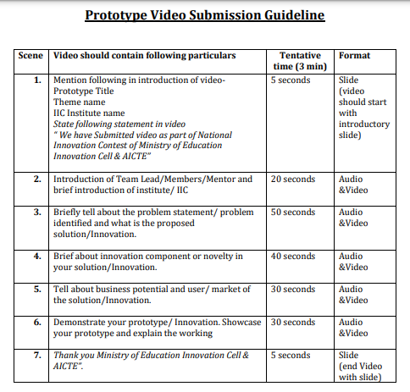
Assignment 4: Recent Images of Prototype/Innovation
Place at least two –three recent images of your product/innovation
&
Place the URL of maximum 3 minutes video on your product/innovation. Refer video preparation guideline
Note:
If video contains the IP component then video may be uploaded in the google drive and access shall be given to yukti@aicte-india.org
Due to ease of accessibility, the video may be uploaded on YouTube and video link should be provided.
Only provide video URL/Link and no video should be sent in email to MIC

Slide 9
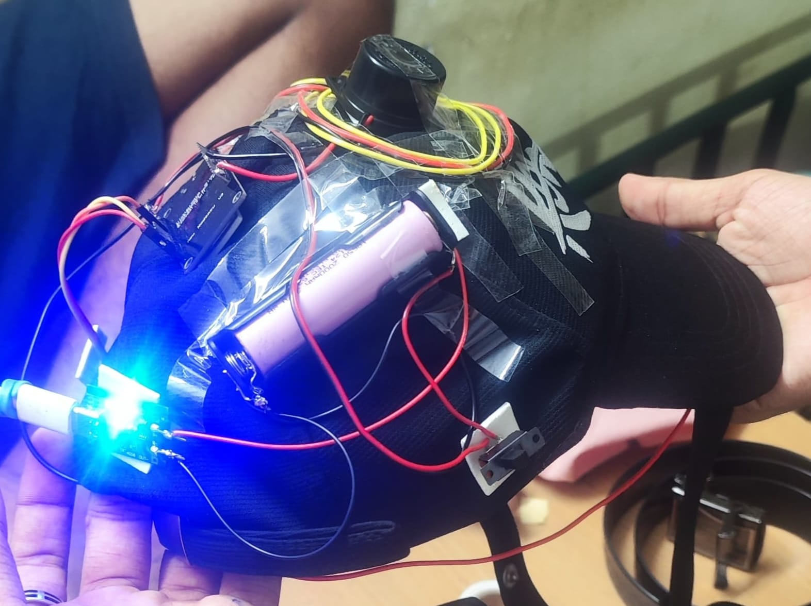
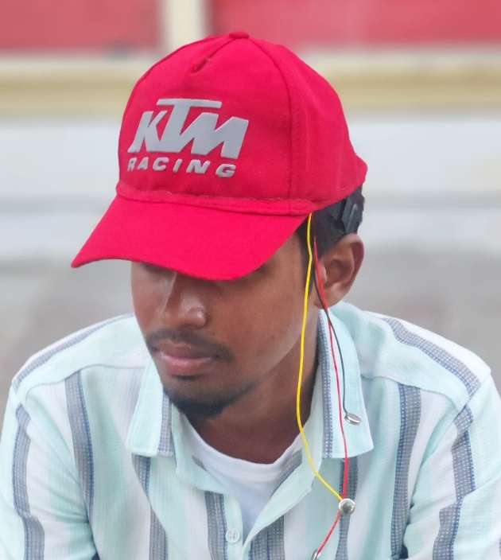
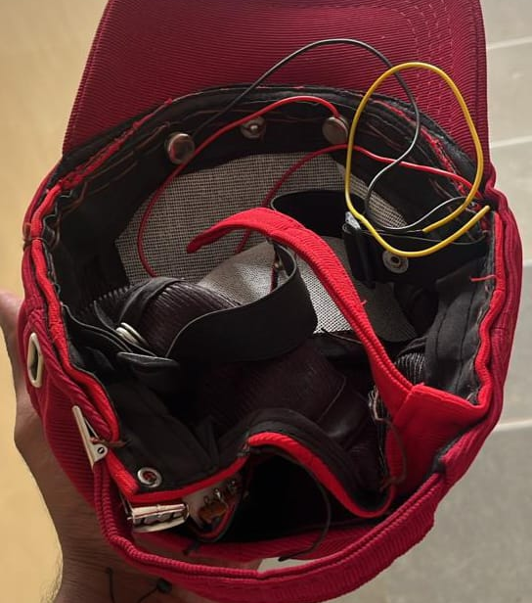

Slide 10
Assignment 5: Submit Brief Presentation on your Innovation and Business Opportunity Plan

Slide 11
1. The Overview
Create a very high-level overview of your product or service
The Wearable Brainwave Monitoring Cap is an EEG-based stress detection system that continuously monitors brainwave activity to identify cognitive stress in real time. It alerts users through a mobile app and provides personalized stress-relief recommendations using scientifically validated techniques
This solution bridges the gap between mental health awareness and real-time monitoring by offering a portable, affordable, and non-invasive device for students, professionals, and defense personnel.
LEARN NOW

Slide 12
2. The Problem
What problem are you trying to solve? Is it really a problem?
Cognitive stress is rising dramatically in high-pressure environments such as education, corporate workplaces, and defense.
Existing stress detection methods rely on subjective questionnaires or expensive clinical tools, making real-time monitoring difficult and inaccessible.
Without timely detection, stress negatively impacts mental health, productivity, decision-making, and overall well-being.
LEARN NOW

Slide 13
3.The Solution
Describe how are you solving the problem
Our solution integrates an EEG sensor-based cap that captures alpha and beta brainwave activity from the prefrontal cortex.
Using real-time signal processing, the system identifies elevated stress levels and sends alerts through a mobile app.
The app then recommends personalized stress-relief activities such as meditation or calming music and tracks stress trends for long-term analysis.
LEARN NOW

Slide 14
4. The Product/Service
Describe how are you solving the problem
Features:
Real-time stress alerts
Stress-level visualization
Personalized stress-relief recommendations
Historical tracking and pattern analysis
Portable, cost-effective, and non-invasive
Hardware: Lightweight wearable cap with an EEG sensor band
Software: Mobile app with real-time monitoring dashboard
LEARN NOW

Slide 15
5. Market & Opportunity
Describe/Highlight the size of your target market
Target segments include:
Students (exam stress, academic pressure)
Corporate professionals (workload, burnout)
Healthcare patients (mental health monitoring)
Defense personnel (high-stress environments)
The global wearable neurotechnology market is projected to exceed $5 billion by 2030.
LEARN NOW

Slide 16
6. The Technology/Innovation
Describe the technologies you are using to solve the problem
EEG-based sensing: Captures electrical brainwave signals
Signal Processing: Filters and analyzes alpha/beta wave ratios
IoT Data Transmission: ESP32 module sends data to Firebase
Mobile App Integration: Real-time dashboard + smart alerts
AI-based analytics (future scope): Predictive stress modeling
Non-Invasive Wearable Tech: Comfortable and safe for long-term use
LEARN NOW

Slide 17
7. Competitive Landscape
What are the alternative solutions available in the market?
Our competitive advantages:
Real-time EEG-based cognitive stress detection
Portable, affordable, and easy-to-wear design
Instant mobile alerts + personalized stress management
Cloud-based long-term analytics
Most competitors rely on heart-rate or skin-conductance sensors, which detect stress indirectly and less accurately. Clinical EEG devices are accurate but bulky and expensive.
LEARN NOW

Slide 18
8. Business Model
What is your revenue model?
B2C Model (Individuals):
Sale of wearable cap
Mobile app subscription (premium analytics, advanced insights, guided meditation library)
B2B Model (Institutions):
Bulk sales for corporates, educational institutions, hospitals, and defense
Enterprise dashboard subscription
Licensing for stress monitoring programs
LEARN NOW

Slide 19
9 Traction
Customer Validation
Prototype successfully developed and tested
Data transmission and mobile dashboard fully functional
Positive feedback from initial test users (students/professionals)
Identified strong demand during surveys in academic and corporate sectors
Ready for pilot implementation in educational institutions
LEARN NOW

Slide 20
10. Resource Mobilisation Plan
What is your Resource Mobilization Strategy and What you have done so far?
Already Achieved:
Built functional prototype using ESP32 + EEG sensor
Developed mobile app and Firebase architecture
Conducted initial testing and validation
Future Requirements:
Funding for mass production and hardware refinement
Partnerships with healthcare experts for validation
Collaboration with corporates/schools for pilot testing
LEARN NOW

Slide 21
11. Way forward Strategy
What is your implementation strategy in short-term, midterm and long-term?
Short-Term (0–6 months):
Improve sensor accuracy and comfort design
Conduct pilot studies in colleges and companies
Strengthen app UI/UX and add more stress-relief tools
Mid-Term (6–18 months):
Scale production and establish B2B partnerships
Launch national-level marketing campaign
Integrate AI-based predictive stress modeling
Long-Term (18+ months):
Expand into international markets
Develop advanced variants (multi-sensor, military-grade)
Integrate with mental health platforms and telemedicine
LEARN NOW

Slide 22
12. The Team
Show the people behind the idea and briefly describe their role
Electronics Developer: Handles EEG integration, ESP32 programming
Software/App Developer: Builds mobile app and Firebase backend
Data Analyst: Manages signal processing and stress algorithm
Project Lead: Coordinates development, documentation, and deployment
LEARN NOW

Slide 23
13. Contact
Leave your contact details and let people know how to reach you quickly
Team members: Sri Venkata Krishna
Phone: 9989402587
Team members : S Sidesh Raj
Phone: 9942731253
Team members : N Gokul Hutaasan
Phone: 6304554987
Team members : Y Surya Prathapa Reddy
Phone: 7780393847
Team members : D Vinithri
Phone: 8977952958
LEARN NOW

Slide 24
Thankyou

